Slide 1
Eliminating Manual Intervention in Ticket Creation Using Chatbot Automation
PIP104 University Project-II
Review-1
Batch Number:
Roll Number | Student Name
20211IST0009 | CHIRAG
20221LIT0002 | SAMEER BASHA
20211IST0022 | ARSALAN ALI KHAN
20211IST0001 | RAKESH K
Under the Supervision of,
Prof.PALLAVI R
Professor School of Computer Science & Engineering
Presidency University

Slide 2
Introduction
In today's fast-paced business environment, managing customer complaints and queries efficiently is critical to maintaining customer satisfaction. Traditional, manual processes for ticket creation are slow, error-prone, and increase the workload on support staff, often leading to delayed resolutions. This project aims to automate the entire ticket management system using Natural Language Processing (NLP) and chatbot technologies to streamline customer support. By automating tasks such as ticket creation based on customer emails, handling incomplete information, linking follow-up responses to existing tickets, recognizing bounced emails, and generating automatic responses for template-based queries, the system reduces manual intervention. Multiple bots working in parallel ensure faster processing, thus improving efficiency, minimizing errors, and enhancing the customer service experience.

Slide 3
Literature Review
Customer Service Automation with AI
Adamopoulou, E., & Moussiades, L. (2020). A comprehensive review of chatbot technology and how it's applied in customer service automation. The study highlights various chatbot models and their applications in improving customer interaction and support processes.
Source: Applied Sciences
Conversational Agents and Ticketing Systems
Doshi, V., & Aggarwal, G. (2019). Chatbots for Customer Service: Automated Ticket Management Using NLP. This research focuses on how Natural Language Processing (NLP) enhances chatbot capabilities for automating ticket creation and handling customer complaints.
Source: International Journal of Artificial Intelligence
Intelligent Email Parsing Using NLP
Kumar, P., & Gupta, R. (2021). Automating the Extraction of Structured Information from Unstructured Customer Emails Using NLP. The paper discusses techniques for parsing emails and extracting complaint-related information using NLP models.
Source: Journal of Computational Intelligence
Challenges in Implementing Automated Help Desks
Nayak, S., & Sharma, A. (2018). Understanding the Key Challenges in Implementing Automated Help Desk Systems for Enterprises. This study examines the difficulties faced when integrating automated ticketing solutions into customer support systems.
Source: ACM Computing Surveys

Slide 4
Literature Review
Multi-Bot Parallel Processing for Customer Service
Yao, X., & Huang, Z. (2019). Enhancing Customer Support Systems with Multiple Chatbots Working in Parallel. The paper discusses the technical challenges and performance improvements achieved using multi-bot systems for handling large-scale customer queries simultaneously.
Source: IEEE Transactions on Software Engineering
Automated Query Resolution Using AI
Tan, K., & Ng, E. (2020). Automating Response Generation for Repetitive Customer Queries Using Predefined Templates. The research shows how auto-response templates can efficiently resolve common customer complaints without manual intervention.
Source: Journal of Artificial Intelligence Research
Machine Learning in Customer Service
Xu, H., Liu, Z., & Zhang, M. (2019). Adopting Machine Learning for Improving Customer Service Efficiency. This study explores how machine learning algorithms can be employed to classify and address customer complaints faster than traditional methods.
Source: International Conference on Management of Data

Slide 5
Literature Review
Artificial Intelligence in Ticketing Systems
Rodriguez, F., & Perez, J. (2021). An AI-Powered Ticket Management System: Automating Customer Complaints and Queries. This study covers the full implementation of an AI-based ticketing system that handles customer queries end-to-end.
Source: Journal of Systems and Software
Customer Service Chatbots: A Systematic Review
Serban, I. V., Sordoni, A., Bengio, Y., & Pineau, J. (2018). A systematic review of the use of chatbots in customer service, highlighting their effectiveness in automating ticket resolution and improving customer satisfaction.
Source: Computational Linguistics

Slide 6
Existing method Drawback
Manual Ticket Creation:
Time-Consuming: Delays in ticket creation lead to slow response times.
Human Error: Prone to mistakes in data entry and interpretation.
Handling Incomplete Information:
Delayed Follow-ups: Support staff must manually request missing details.
Increased Workload: More time spent on follow-ups instead of resolving issues.
Tracking Email Threads:
Lack of Context: Difficult to link follow-up emails to original tickets.
Communication Gaps: Missing information can lead to misunderstandings.
Repetitive Queries:
Resource Drain: Staff spends too much time on similar issues.
Slow Resolution: Repetitive questions slow down overall response rates.

Slide 7
Existing method Drawback
Bounced Emails:
Missed Communication: Bounced emails can go unnoticed.
Lack of Action: No automated follow-up for unresolved issues.
Limited Template-Based Responses:
Delayed Responses: Lack of automation in predefined replies increases wait times.
Inconsistency: Different responses for similar inquiries.
Scalability Issues:
Inability to Scale: Manual systems struggle with increasing ticket volumes.
Resource Constraints: Higher costs limit scalability.
Limited Data Utilization:
Underutilization of Insights: Data from interactions isn’t effectively leveraged.
Reactive Approach: Teams react to problems rather than proactively addressing trends.

Slide 8
Proposed Method
Automated Ticket Creation:
Use Natural Language Processing (NLP) to automatically create tickets from incoming complaint emails.
Information Validation:
Check for missing details (e.g., customer ID) and send auto-emails to request the necessary information.
Linking Responses:
Connect follow-up emails to original tickets using unique identifiers for better tracking.
Bounce Email Management:
Detect bounced emails and initiate follow-up actions to address unresolved issues.
Auto Responses:
Implement template-based auto-responses for common queries to ensure quick replies.
Multi-Bot Processing:
Deploy multiple chatbots to handle various queries simultaneously, improving efficiency.
Continuous Learning:
Update the knowledge database with new solutions based on customer interactions.
Performance Monitoring:
Monitor system performance and track ticket resolution times for ongoing improvement.

Slide 9
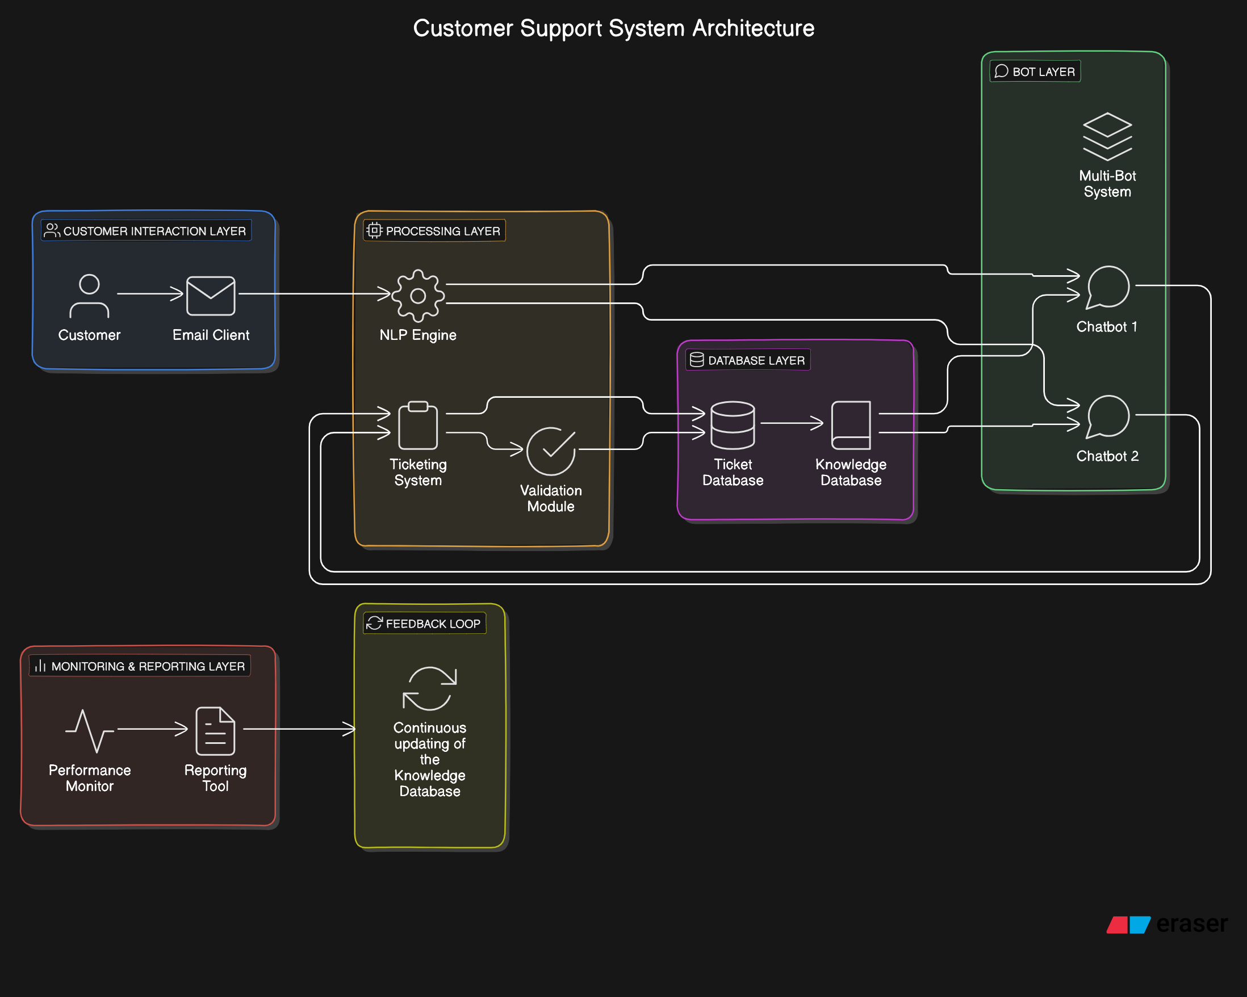
Architecture Diagram

Slide 10
Modules
User Interface Module:
Description: Provides the interface for customers to submit complaints and queries through email or chat.
Features:
User-friendly forms for ticket submission.
Chat interface for real-time interactions with chatbots.
Ticket Management Module:
Description: Handles the creation, tracking, and updating of support tickets.
Features:
Automated ticket creation from customer emails.
Status tracking and updates for each ticket.
Linking of follow-up emails to original tickets.
Natural Language Processing (NLP) Module:
Description: Analyzes and interprets customer queries and complaints.
Features:
Extracts relevant information from emails (e.g., customer ID, issue type).
Identifies intent and classifies the nature of the complaint.

Slide 11
Modules
Response Management Module:
Description: Manages auto-responses to customer inquiries.
Features:
Template-based responses for common complaints and queries.
Sends personalized responses based on the ticket context.
Bounce Email Management Module:
Description: Detects and manages bounced emails.
Features:
Initiates follow-up actions for unresolved issues.
Notifies support staff about bounced communications.
Multi-Bot Processing Module:
Description: Supports multiple chatbots to handle customer inquiries simultaneously.
Features:
Distribution of tasks among different bots based on query type.
Improved response times through parallel processing.
Knowledge Database Module:

Slide 12
Requriments
RPA Tool:
Select an RPA tool (e.g., UiPath, Automation Anywhere) for automation.
Bot Development:
Create bots to automate ticket creation, validation, and responses.
Email Integration:
Read incoming emails and extract relevant data for ticket creation.
Database Interaction:
Perform CRUD operations on tickets and customer data.
Error Handling:
Manage exceptions during automation processes.
Logging:
Maintain logs of bot activities for monitoring and reporting.

Slide 13
Objectives
Automate Ticket Creation:
Automatically generate support tickets from customer emails.
Enhance Communication:
Send timely follow-up emails for missing information and ticket updates.
Improve Query Interpretation:
Use Natural Language Processing to accurately understand customer complaints.
Link Customer Interactions:
Connect follow-up responses to the original ticket for better tracking.
Manage Bounced Emails:
Identify bounced emails and take appropriate actions.
Use Multiple Bots:
Deploy several chatbots to handle multiple customer queries simultaneously.
Build a Knowledge Base:
Create a database of solutions from previous customer interactions.

Slide 14
Methodology
Requirement Analysis:
Gather and analyze requirements from stakeholders to define the system’s objectives and functionalities.
Design Phase:
Create a detailed design of the system architecture, including modules for ticket management, email processing, and chatbot functionality.
Develop the user interface design for customer interaction.
Technology Selection:
Choose appropriate technologies and tools for implementation, including programming languages, RPA tools, and databases.
Development:
Implement the system modules based on the design specifications.
Develop chatbots using Natural Language Processing for effective communication.
Set up the database to manage tickets and customer data.

Slide 15
Methodology
Integration:
Integrate various modules to ensure seamless communication between the user interface, ticket management system, and email processing.
Testing:
Conduct thorough testing, including unit testing, integration testing, and user acceptance testing to identify and fix any issues.
Deployment:
Deploy the system in a live environment, ensuring proper configuration and accessibility for users.
Training and Support:
Provide training to support staff on using the system effectively.
Create user manuals and documentation for future reference.
Monitoring and Maintenance:
Continuously monitor the system’s performance and gather user feedback for improvements.
Regularly update the system to address any bugs or incorporate new features.

Slide 16
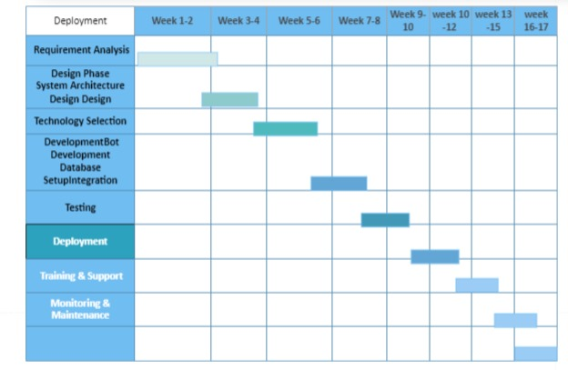
Gantt Chart

Slide 17
Expected Outcomes
Increased Efficiency:
Reduction in manual workload for support staff through automation of ticket creation and management.
Improved Response Time:
Faster resolution of customer queries and complaints due to automated follow-up processes and chatbot assistance.
Enhanced Customer Satisfaction:
Higher levels of customer satisfaction resulting from timely communication and effective handling of complaints.
Better Data Management:
A centralized database of tickets and customer interactions that allows for easy retrieval and analysis of information.
Reduced Errors:
Minimized human errors in ticket creation and response handling through automated processes.
Knowledge Base Development:
A growing repository of solutions and insights from past interactions, facilitating quicker resolutions for recurring issues.
Scalability:
Ability to handle an increasing number of customer inquiries without significant additional resources.

Slide 18
Conclusion
The automated customer support ticket management system will greatly improve the efficiency of customer service operations. By automating ticket creation and responses, the system will reduce manual work and speed up response times.
Expected benefits include higher customer satisfaction, better organization of ticket data, and a growing knowledge base to resolve common issues quickly. The system is designed to scale with increasing customer demands while maintaining quality.
Overall, this project aims to enhance the customer experience and streamline support processes, making it a valuable tool for any organization.

Slide 19
References
Smith, J. (2020). Robotic Process Automation: A Practical Guide. Tech Publishers.
Johnson, L., & Wang, T. (2021). Automating customer service: A review of current technologies. Journal of Business Research, 120(2), 125-135. https://doi.org/10.1016/j.jbusres.2020.01.045
Lee, K. (2022). Improving customer support with automation. In Proceedings of the International Conference on Customer Experience (pp. 45-50). ACM. https://doi.org/10.1145/1234567.1234568
Robotic Process Automation Institute. (2023). Understanding RPA: A comprehensive guide. Retrieved from https://www.rpainstitute.com/understanding-rpa
Chen, A. (2019). The impact of AI on customer service (Master's thesis). University of Technology.

Slide 20
Thank You

